Slide 1
Teeth

Slide 2
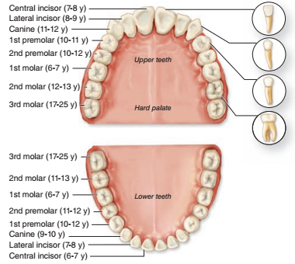
introduction
In the adult human there are normally 32 permanent teeth.
Arranged in two bilaterally symmetric arches in the maxillary and mandibular bones
Each quadrant has eight teeth.
Two incisors, one canine, two premolars, and three permanent molars.
Twenty of the permanent teeth are preceded by primary teeth (deciduous or milk teeth) that are shed; the others are permanent molars with no deciduous precursors

Slide 3
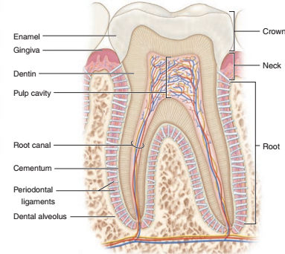
STRUCTURE OF THE TOOTH
Each tooth consist of :
1- The crown:
exposed above the gingiva.
covered by very hard, acellular enamel.
2.The neck:
The constricted part at the gum .
3. The roots:
one or more root
fit firmly into bony sockets in the jaws called dental alveoli
The roots covered by a bone-like tissue called cementum.
The enamel and the cementum coverings meet at the neck of the tooth.

Slide 4
The bulk of a tooth is composed of another calcified material, dentin, which surrounds an internal pulp cavity .
4.The Dental pulp :
highly vascular
well-innervated
consists largely of loose, mesenchymal connective tissue with much ground substance, thin collagen fibers, fibroblasts, and mesenchymal stem cells.
The pulp cavity narrows in each root as the root canal
5. The root canal:
extends to an opening (apical foramen) at the tip of each root for the blood vessels, lymphatics, and nerves of the pulp cavity.
6. The periodontal ligaments:
fibrous connective tissue bundles of collagen fibers inserted into both the cementum and the alveolar bone.

Slide 5
Dentin
calcified tissue harder than bone, consisting of 70% hydroxyapatite
The organic matrix contains type I collagen and proteoglycans secreted from the apical ends of odontoblasts.
Odontoblasts :
Tall polarized cells derived from the cranial neural crest that line the tooth’s pulp cavity
odontoblasts and most tissues of the pulp cavity develop from neural crest cells and mesoderm.
Secret predentin matrix
Long apical odontoblast processes extend from the odontoblasts within dentinal tubules
odontoblast processes penetrate the full thickness of the dentin
The odontoblast processes are important for the maintenance of dentin matrix
Odontoblasts continue predentin production into adult life, gradually reducing the size of the pulp cavity, and are stimulated to repair dentin if the tooth is damaged.

Slide 6
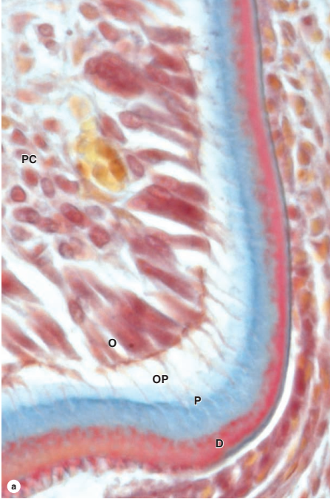
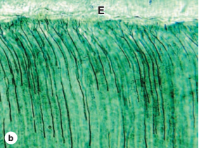
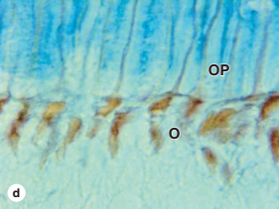
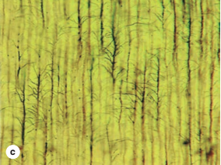
Teeth are sensitive to stimuli such as cold, heat, and acidic pH, all of which can be perceived as pain. Pulp is highly innervated, and unmyelinated nerve fibers extend into the dental tubules along with odontoblast processes near the pulp cavity .
Such stimuli can aﬀect ﬂuid inside the dentinal tubules, stimulating these nerve fibers and producing tooth sensitivity.

Slide 7
Enamel
is the hardest component of the human body, consisting of 96% calcium hydroxyapatite and only 2%-3% organic material including very few proteins and no collagen.
Other ions, such as ﬂuoride, can be incorporated or adsorbed by the hydroxyapatite crystals; enamel containing ﬂuorapatite is more resistant to acidic dissolution caused by microorganisms, hence the addition of ﬂuoride to toothpaste and water supplies.
Enamel consists of uniform, interlocking columns called enamel rods (or prisms)
The enamel rods :
Each about 5 μm in diameter and surrounded by a thinner layer of other enamel
Extends through the entire thickness of the enamel layer
Arranged in interlocked manner , this is crucial for enamel’s hardness and resistance to great pressures during mastication
the matrix for the enamel rods is secreted by tall, polarized cells, the ameloblasts.

Slide 8
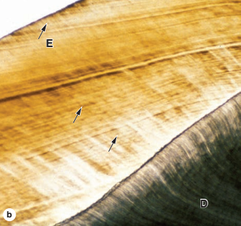
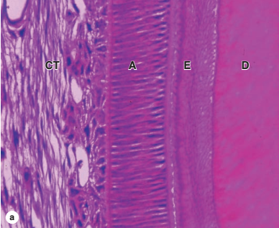
Ameloblasts
Are part of a specialized epithelium in the tooth bud called the enamel organ
They are tall, polarized cells
Its apical ends face those of the odontoblasts producing predentine
Derived from the ectodermal lining of the embryonic oral cavity .
The ameloblast (or Tomes) process:
Apical extension from each ameloblast
Contains numerous secretory granules with the proteins of the enamel matrix.
Growth of the hydroxyapatite crystals to produce each elongating enamel rod is guided by a small (20 kDa) protein amelogenin, the main structural protein of developing enamel.

Slide 9
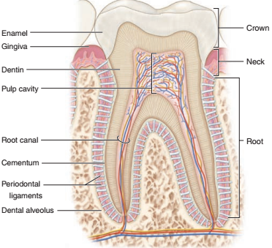
Periodontium:
Responsible for maintaining the teeth in the maxillary and mandibular bones
Includes the cementum, the periodontal ligament, and the alveolar bone with the associated gingiva.
Cementum:
covers the dentin of the root and resembles bone, but it is avascular
It is thickest around the root tip where cementocytes reside in lacunae with processes in canaliculi, especially near the cementum surface
cementocytes maintain their surrounding matrix and react to stresses by gradually remodeling

Slide 10
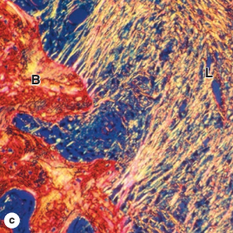
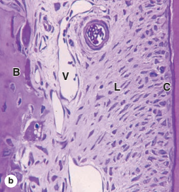
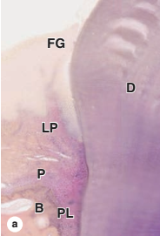
The periodontal ligament:
fibrous connective tissue with bundled collagen fibers (Sharpey fibers)
binding the cementum and the alveolar bone.
highly cellular and has a rich supply of blood vessels and nerves.
Has sensory and nutritive functions in addition to its role in supporting the tooth
permits limited movement of the tooth within the alveolus and helps protect the alveolus from the recurrent pressure exerted during mastication

Slide 11
The alveolar bone:
Lacks the typical lamellar pattern of adult bone
Has osteoblasts and osteocytes engaging in continuous remodeling of the bony matrix
surrounded by the periodontal ligament, which serves as its periosteum
Collagen fiber bundles of the periodontal ligament penetrate this bone, binding it to the cementum .
Around the peridontium the keratinized oral mucosa of the gingiva is firmly bound to the periosteum of the maxillary and mandibular bones
Between the enamel and the gingival epithelium is the gingival sulcus
The gingival sulcus:
A groove up to 3 mm deep surrounding the neck.
specialized part of this epithelium, the junctional epithelium,
is bound to the tooth enamel by means of a cuticle, which
resembles a thick basal lamina to which the epithelial
cells are attached by numerous hemidesmosomes.

Slide 12
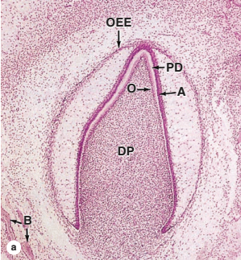
Teeth formation
begins in the embryo when ectodermal epithelium lining the oral cavity grows into the underlying mesenchyme of the developing jaws.
At a series of sites corresponding to each future tooth, these epithelial cells proliferate extensively and become organized as enamel organs, each shaped like a wine glass with its stem initially still attached to the oral lining. Ameloblasts form from the innermost layer of cells in the enamel organ.
Mesenchymal cells inside the concave portion of the enamel organ include neural crest cells that diﬀerentiate as the layer of odontoblasts with their apical ends in contact with the apical ends of the ameloblasts.
Together, these tissues produce a series of 52 tooth buds in the developing oral cavity, 20 for the primary teeth and 32 for the secondary or permanent teeth.
Primary teeth complete development and begin to erupt about
6 months after birth. Development of the secondary tooth
buds arrests at the “bell stage,” until
about 6 years of age, when these teeth begin to erupt as the
primary teeth are shed.

Slide 13
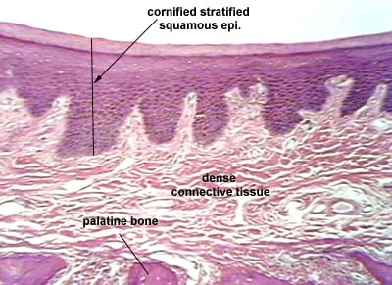
The palate
The hard palate:
Separate the oral cavity from the nasal cavities
Consist of bony plate covered above and below by mucosa
Above :
It is covered by respiratory type mucosa and form the flower of the nasal cavities.
Below :
It is covered by tightly bound layer of oral mucosa and forms much of the roof of the oral cavities.
Keratinized stratified squamous epithelium
Dense irregular collagenous C.T.
Rests on bony tissue

Slide 14
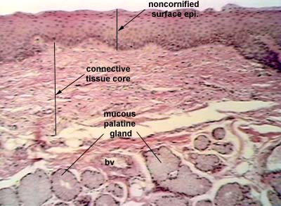
The soft palate
Oral surface :
Non keratinized stratified squamous epithelium
Irregular collagenous C.T.
Minor salivary glands
Nasal surface :
Pseudostratified columnar ciliated epithelium
Lamina propria
Mucous glands
Striated muscles

Slide 15
The gingiva= gum
Found in the oral cavity surrounding part of teeth
Two types :
Marginal gingiva :
Mobile
Surround the tooth neck
The inner wall forms the gingival wall of the sulcus
Attached gingiva:
is the gingival tissue which lies between the mobile gingiva and the alveolar gingiva.
It is four to five millimeters in width and is irremovable from the underlying structures without causing damage

Slide 16
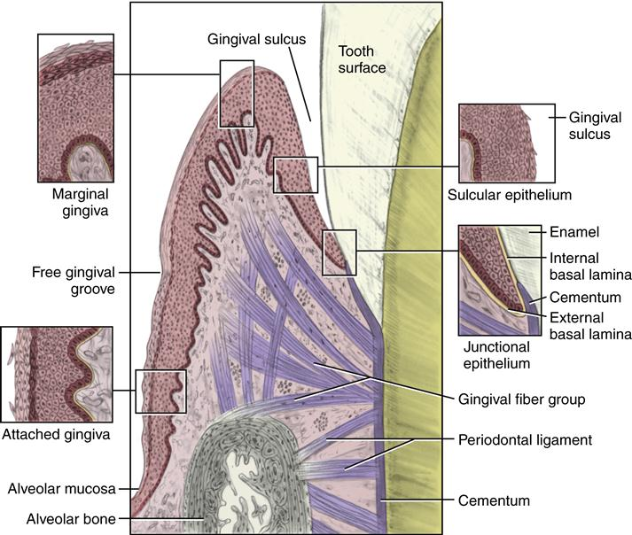
The gingival epithelium encompasses the external surface of the gingiva including the mobile and fixed areas as well as the gingival sulcus and the junctional epithelium.
It is divided up into three major parts :
oral epithelium: stratified squamous keratinizing epithelium
covers the oral and vestibular gingival surfaces
The sulcular epithelium: continuous with the oral epithelium and lines the gingival sulcus.
The junctional epithelium: lines the dentoepithelial junction.
The lamina propria composed of long
Narrow papillae that are not highly vascular
The mucosa is directly attached to the
Underlying periosteum and cementum by
Collagen fibers.
No distinct submucosa

Slide 17
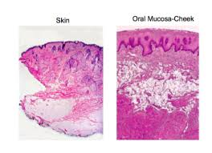
Cheeks :
Fibro elastic tissue and skeletal muscle
Outside lined by the skin of the face
Inside lined by the oral mucosa with non keratinized stratified squamous epithelium and lamina propria
The submucosa of the cheeks contained abundant elastic fibers, fat cells and small mixed serous and mucous glands, thus preventing folding of the mucosa and the glands help in lubrication of the mouth.

Slide 18
THANKS

